Slide 1
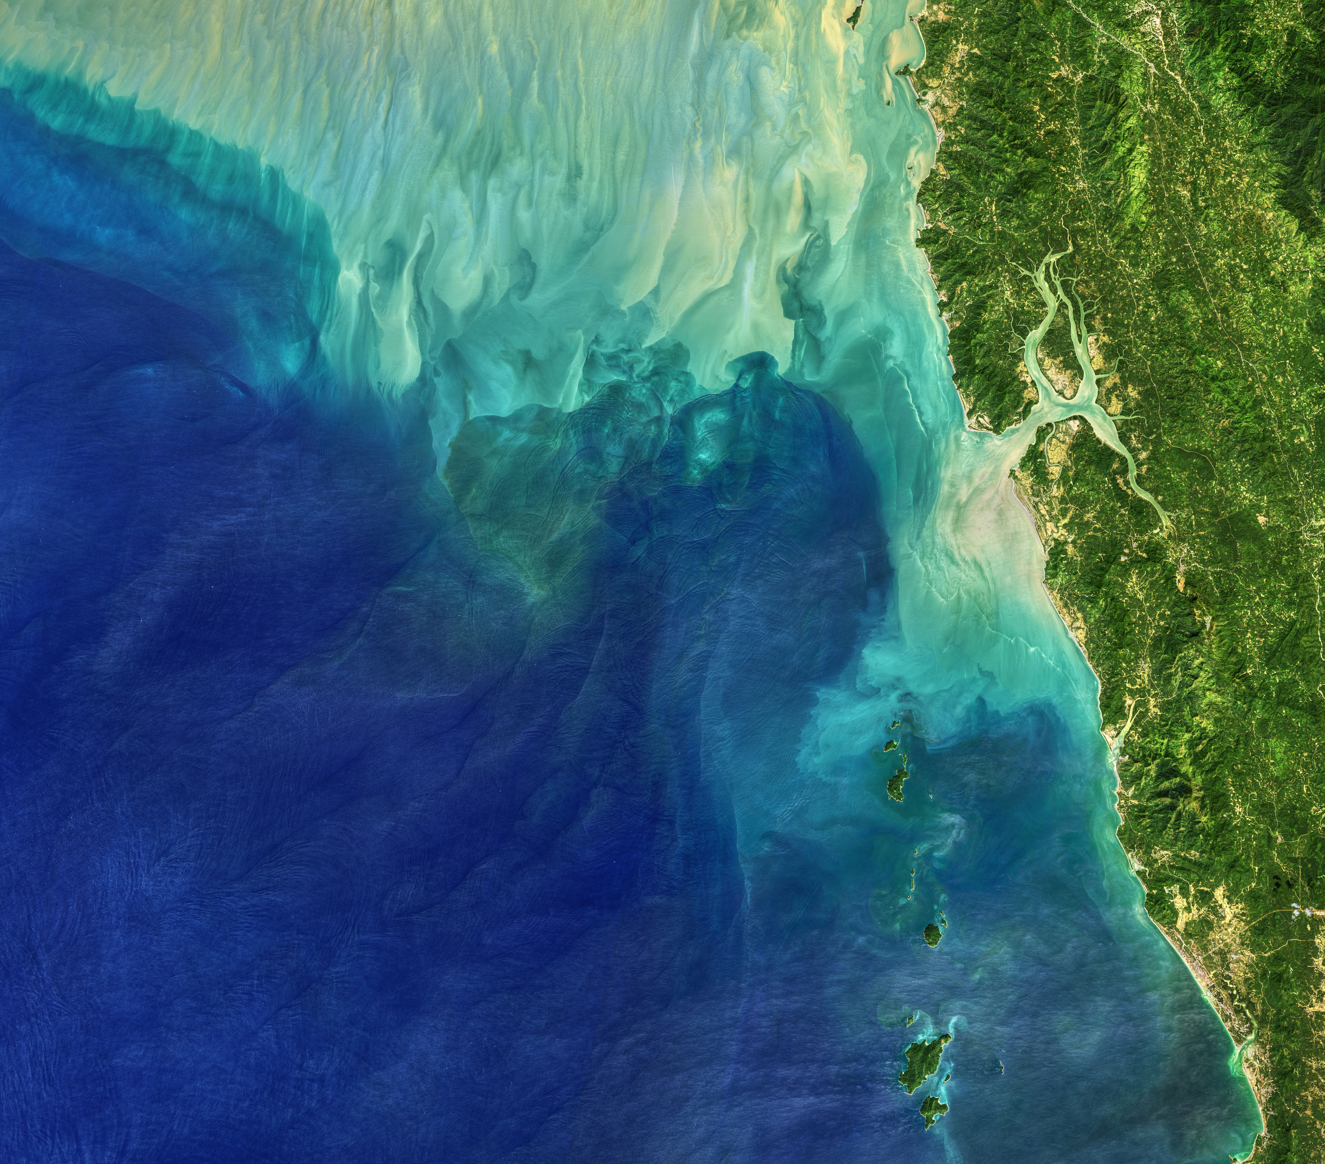



Using Remote Sensing to Determine Vegetation Change and Impacts to Communities. Case Study in Eastern Jamaica – Hurricane Matthew
NORTHERN ARIZONA UNIVERSITY
By Jacob Cain, with Dr. McDonnell at Northern Arizona University
Arizona Space Grant Symposium April 17, 2021
ARIZONA
SPACE GRANT CONSORTIUM
Image Source: NASA Visible Earth – Landsat 8 – Making Waves in the Andaman Sea

Slide 2
Methodology
Remote Sensing (RS)
NASA’s Landsat 8 satellite captures multi-band images that give us near bi-weekly data about Earth’s surface.
Geographic Information System (GIS)
A GIS is used to make calculations about and visualize data.
Images, lines, and polygons show data about vegetation, terrain height, roads, and cities.
Comparing images from before and after an event (like a storm) can indicate which places were impacted by the event.

Slide 3
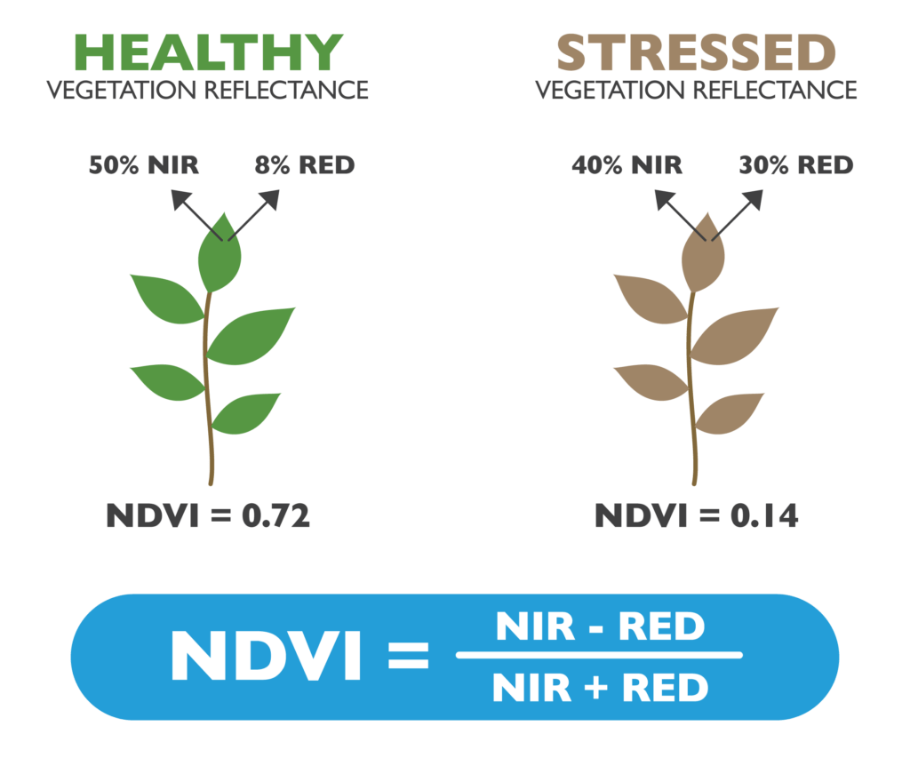
NDVI
Normalized Difference Vegetation Index
Indicates health of vegetation
Uses Landsat 8 Imagery
Combines info from Red and Near Infrared (NIR) bands
Remote Sensing
NDVI can be calculated from remote images, and could be used to make damage estimates faster compared to on-site surveying.
Image Source: Agricolus NDVI Vegetation Index – Instructions For Use

Slide 4
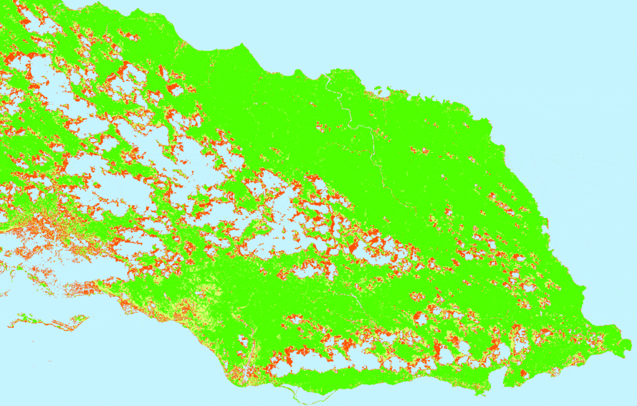
Results
NDVI
Before and After Hurricane Matthew
Green: Healthy Vegetation
Yellow: Stressed Vegetation
Red: Damaged Vegetation*
Blue: Clouds and Water
* Note: Some judgement is needed to determine which spots are clouds and which are Damaged Vegetation, as the data values produced by images of clouds may overlap into the Damaged Vegetation classification.

Slide 5
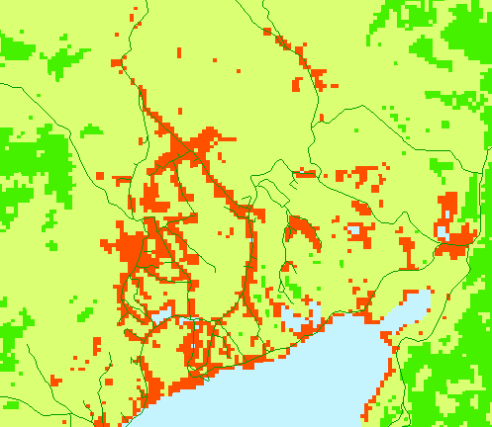
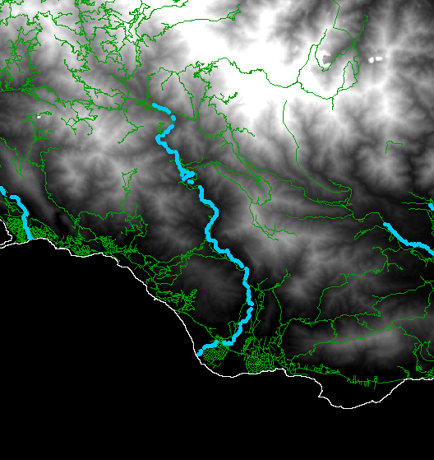
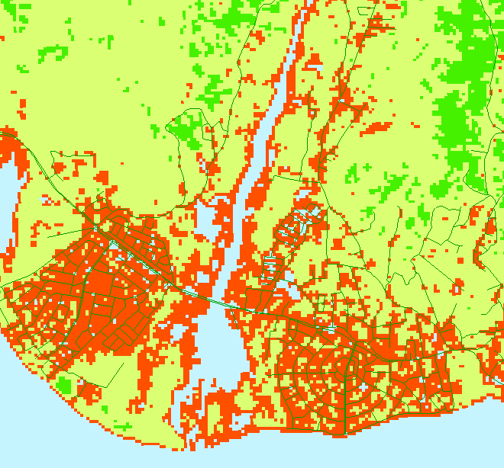
Impact to Communities
Albion
South Haven
Vegetation Damage (NDVI)
These roads have likely been impacted and may require an emergency response.
Flow Accumulation (calculated from terrain heights)
Excess water during a storm will flow here. Areas near this heavy flow may be impacted.
Vegetation Damage (NDVI)
Following the flow accumulation, we find that South Haven and Albion have heavy vegetation damage, and may be impacted.

Slide 6
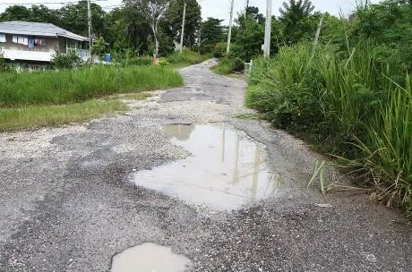
Conclusion
Data from remote sensing can show where vegetation has been damaged by a storm.
Vegetation damage can help locate infrastructure that was damaged and needs attention.
Questions?
Albion - Bad Road Conditions (The Jamaica Star, http://jamaica-star.com/article/news/20161006/ albion-mountain-residents-cry-road-water)
Albion road conditions were already poor before Hurricane Matthew, but the data in this project shows how they could have reached that condition in the first place.
The flow accumulation shown here is not specific to Hurricane Matthew. High waters are likely here whenever a storm brings enough water.

Slide 7
Thank You
NORTHERN ARIZONA UNIVERSITY
This research was made possible thanks to:
Dr. Dianne McDonnell (Mentor)
Arizona Space Grant
Paloma Davidson
Norther Arizona University
Planetary Sciences, Forestry, and Engineering Departments
Data Providers:
NASA - Landsat 8 Satellite Imagery Data
The World Bank - Digital Elevation Data
Humanitarian Data Exchange - Road Data
Open Street Maps - Road Data
ARIZONA
SPACE GRANT CONSORTIUM

